Slide 1
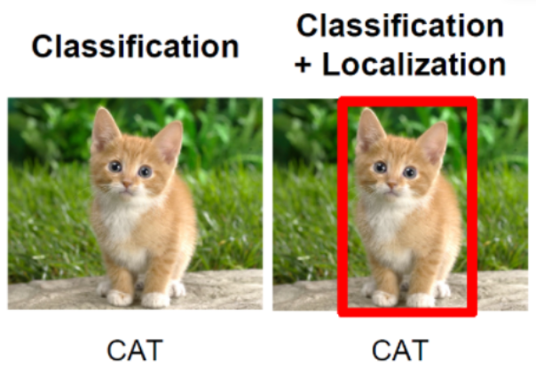
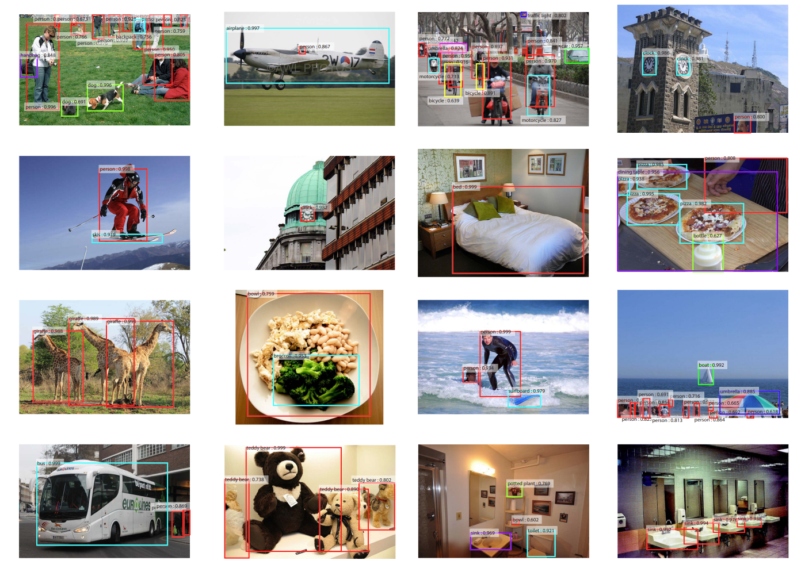
The development of object detection and its methods

Slide 2
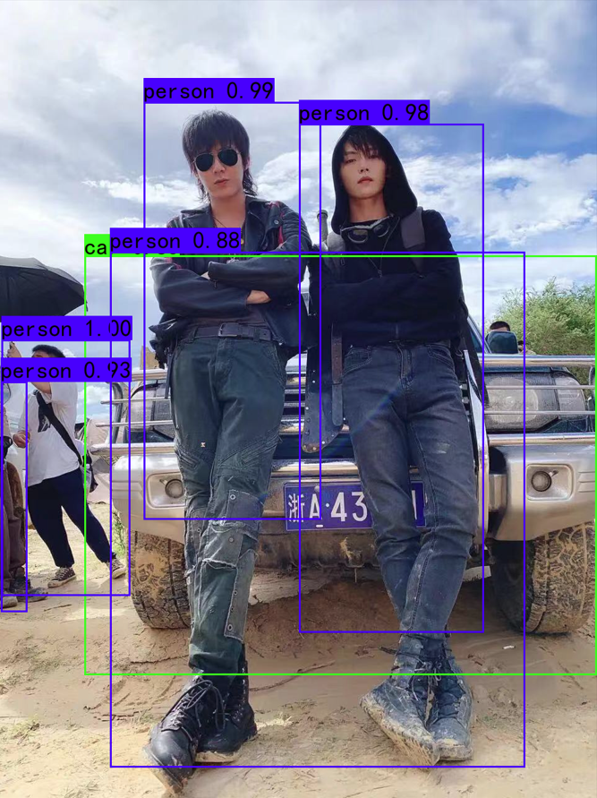
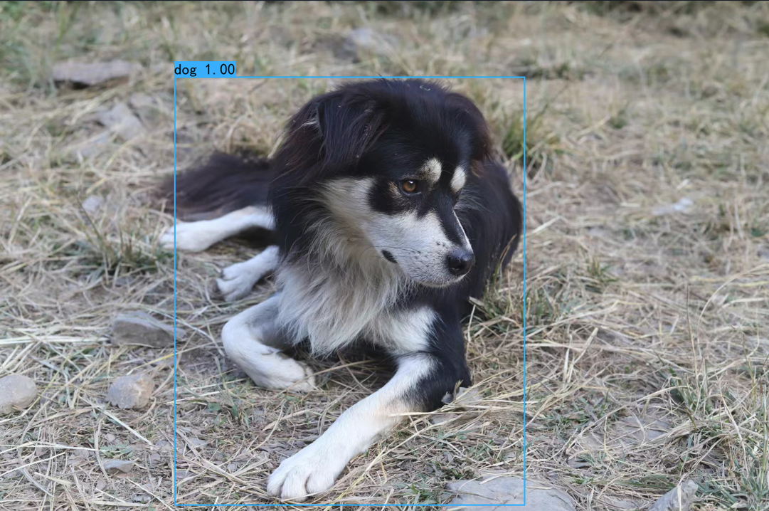

Slide 3
Q: Which of the following is a two-stage object detection algorithm?
R-CNN、Fast R-CNN
Fast R-CNN、Faster R-CNN
YOLO、SSD
SPP-Net、R-CNN

